Slide 1
CSS Hiding Parts of a Page & Transitions

Slide 2
Hiding Parts of a Page
Another CSS property often used with absolutely positioned elements is visibility, which lets you hide part of a page (or show a hidden part).
Say you want a label to pop into view over an image when a visitors mouse moves over it. You make the caption invisible when the page first loads (visibility: hidden), and switch to visible (visibility: visible) when the mouse moves over it.
There’s another way to hide an element
set its opacity to 0
To make it reappear, you can
set its opacity back to 1
The benefit of using opacity is that it’s one of the CSS properties that a browser can animate. This means you can use the CSS transitions to animate changes in opacity. For example, you can make an element appear to fade into view by changing its opacity from 0 to 1 and adding a transition.

Slide 3

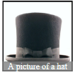
Hiding Parts of a Page (continued)
For example, say you wanted to place a caption over an image, but you only want that caption to show up when a visitors mouse moves over the image. You could do that by following these steps:

Slide 4
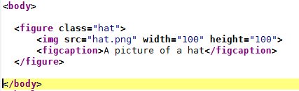
Hiding Parts of a Page (continued)
Create the HTML for the image and caption.
One way to do this would be to use the HTML5 <figure> and <figcaption> tags, like this:
Here you’re applying a class hat to the <figure> tag so you can style just that one figure.

Slide 5
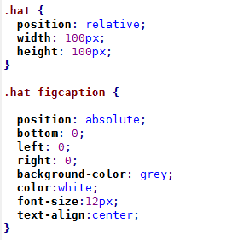
Hiding Parts of a Page (continued)
Position the caption.
To place the caption on top of the image, you use absolute positioning. To place the caption in relation to the img, you should set its parent (the <figure> tag) to relative and also give the parent a set width that matches the dimensions of the photo.
The caption is placed at the bottom of the figure (bottom: 0). By setting its left and right values to 0, it will span the entire width of the figure.

Slide 6
Hiding Parts of a Page (continued)
Hide the caption.
With the current code, a browser would display the caption on top of the image, but you want that to happen only when someone’s mouse hovers over the image. To hide it, you could add any of the following to the .hat figcaption style. We will use the opacity option.
visibility: hidden;
display: none;
opacity: 0;

Slide 7

Hiding Parts of a Page (continued)
Make the caption appear when a visitor moves the mouse over the image.
To do this, you’ll employ a little trick with the :hover pseudo-class. You want to make the caption visible when the visitor moves the mouse over the image. Unfortunately, there’s no way to create a style that affects the caption when the mouse moves over the image. However, since the caption is inside the <figure> tag, you can craft a descendent selector that affects the caption when the mouse moves over the figure:
This descendent selector basically says “target any <figcaption> tag that’s inside an element with the class of hat, but only when the mouse is over that element.” This selector only works because the figcaption tag is a descendent of the element being hovered over.

Slide 8
Transitions
A transition is simply an animation from one set of CSS properties to another set over a specific amount of time.
To make a transition work, you need a few things in place:
Two styles. One style represents the beginning look of the element—a red nav button, for example, while the second style is the ending look—a blue nav button. The web browser will take care of the process of animating the change between the two styles (changing the button from red to blue, for example).
The transition property. CSS3 adds the transition property—the secret sauce that makes the animation possible. In general, you apply the transition property to the original style, the style that defines the look of an element before the animation begins.
A trigger. The trigger is the action that causes the change between the two styles. With CSS, you can use several pseudo-classes to trigger an animation. The most common is the :hover pseudo-class. With it, you can animate the change between an element’s normal appearance and how it looks when a visitor mouses over it.

Slide 9
Transitions(continued)
When the trigger no longer applies—when the visitor mouse moves off a navigation button, for example—then the browser returns the tag back to its previous style and animates the entire process. In other words, you only need to set a transition to an element once, and the browser takes care of animating from one style to another and back to the original style.
A web browser can’t animate every single CSS property, but you still have a long list of properties to choose from. In addition to the rotate, scale, translate, and skew transformations, you can also animate color, background-color, border-color, border-width, font-size, height, width, letter-spacing, line-height, margin, opacity, padding, word-spacing; the positioning properties—top, left, right, and bottom and many other properties.
You can find a complete list at www.w3.org/TR/css3-transitions/#animatable-properties

Slide 10
Adding a Transition
The heart of CSS transitions are four properties that control:
which properties to animate,
how long the animation takes,
the type of animation used,
and an optional delay before the animation begins.

Slide 11
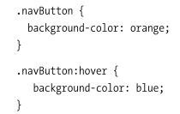
Here’s a simple example.
Say you want a navigation button’s background colour to change from orange to blue when a visitor moves the mouse over it.
First, you start with the two styles needed to switch between these two colours. For example, you can apply a class of .navButton to the link and then create two styles, like this:
These styles will work in any browser; hovering over the nav button will change its background from orange to blue.
However, the change is instantaneous.

Slide 12
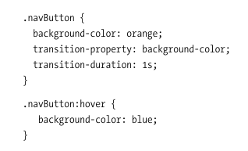
Here’s a simple example (continued)
To make the colour animate over one second, add two new properties to the .navButton style, like this:
The first property transition-property specifies which properties to animate.
To specify how long the animation takes to complete, use the transition-duration property. This property takes either a value in seconds or milliseconds (thousandths of a second). For example, the code below makes a transition take 1 sec.

Slide 13
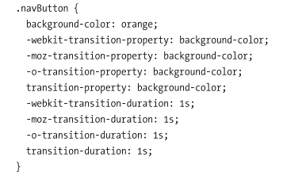
Here’s a simple example (continued)
Unfortunately, like many CSS3 properties, transitions require vendor prefixes to work. In other words, the .navButton example above won’t work in most browsers until you add the proper vendor prefixes, so you need to rewrite that style like this:
You don’t need an -ms vendor prefix for Internet Explorer since IE 9 and earlier don’t understand transitions, and IE 10 understands the non-prefixed versions of the transition properties.

Slide 14
Here’s a simple example (continued)
The CSS browser prefixes are:
Android: -webkit-
Chrome: -webkit-
Firefox: -moz-
Internet Explorer: -ms-
iOS: -webkit-
Opera: -o-
Safari: -webkit-

Slide 15
Here’s a simple example (continued)
To have a working, animated transition, you only need to set transition-property and transition-duration. However, you can control the rate of the animation by using the transition-timing-function property.
This property can be a little confusing: it doesn’t control how long the animation takes (that’s what the transition-duration property is for). Instead it controls the speed during the animation. For example, you can begin the animation slowly and then quickly complete it, creating an effect where the background color changes almost imperceptibly at first and then quickly completes its color change.
The transition-timing-function property can take one of five keywords: linear, ease, ease-in, ease-out, and ease-in-out. If you don’t specify a timing function, the browser uses the ease method, which begins the animation slowly, speeds up in the middle, and slows down at the end, providing a more organic change. The linear option provides a steady change along the entire length of the animation.
No option is really any better than the other, they just provide different looks, so try them out to see which one you like best.

Slide 16

Here’s a simple example (continued)
Of course, as with all of these transition properties, you need to add vendor prefixes as well. So to get this line of code to work in as many browsers as possible, you’ll need to rewrite it as:

Slide 17
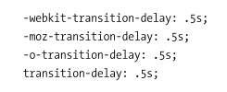
Here’s a simple example (continued)
Finally, you can prevent a transition from animating right away with the transition-delay property. For example, if you want to wait a half second before the animation begins, you can add this code:

Slide 18
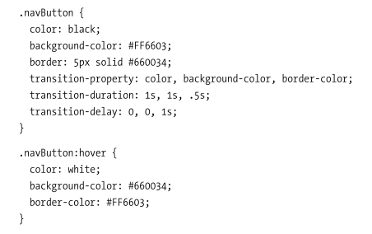
Transition of multiple properties
Say you have a button whose background color and text color you want to change, and then have its border color change suddenly after the other two properties have finished. Here’s how you might do that:

Slide 19

All in 1 go…..
Writing out all the different properties— transition-property, transition-duration, transition-timing-function, and transition-duration—can get pretty tiring. Especially when you consider you need to also create vendor-prefixed versions of each of those as well. Fortunately, there’s a faster way to create transitions the transition property.
This property bundles all of the other properties into one. To use it, simply list the property, duration, timing function, and duration in a space-separated list. For example, to animate all CSS properties for one second using the ease-in timing function, with a half-second delay, write the following:
Multiple properties in 1 go:
One property:

Slide 20
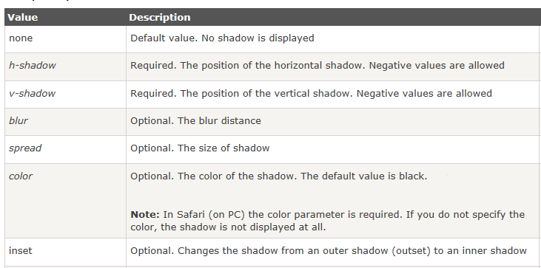
box-shadow property
The box-shadow property attaches one or more drop-shadows to the box.
The box-shadow property is supported in IE9+, Firefox, Chrome, Opera, and Safari 5.1.1

Slide 21
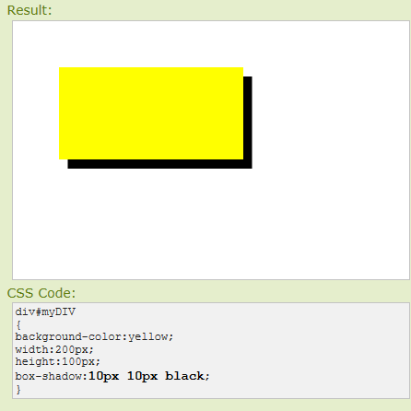
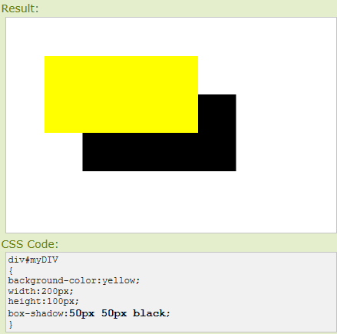

Slide 22

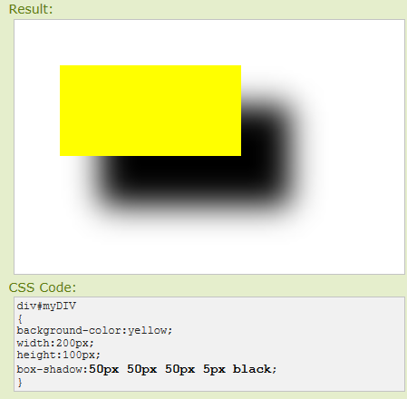

Slide 23
